Slide 1

Predicting Accident severity in Seattle
Coursera
IBM Applied Data Science Capstone
Jon Frampton
Based on Seattle, Washington collision data, 2014-2020

Slide 2
Background
Seattle made collision data public, dating between 2014 and 2020
Objective: Predict accident severity based on the published data
Interest:
City Planners
People, in general
Transportation Manufacturers
Innovators
Insurance Companies

Slide 3
Data, CLEANING, TRANSFORMATION & FEATURE SELECTION
Initial dataset and metadata:
https://www.coursera.org/learn/applied-data-science-capstone/supplement/Nh5uS/downloading-example-dataset
https://s3.us.cloud-object-storage.appdomain.cloud/cf-courses-data/CognitiveClass/DP0701EN/version-2/Metadata.pdf
194673 raw “original” records:
Issues with data completeness, consistency
30483 records removed
Used 164190 records
Transformed data, created:
Human Factors (e.g., speeding, driver inattentiveness)
Environmental Factors (e.g, weather, road condition, lighting condition)
Contributing Factors (i.e., combination of Human and Environmental Factors)
Feature Selection: 19 total
38 original features
Kept: 16 original features
Created 3 more through data transformation

Slide 4
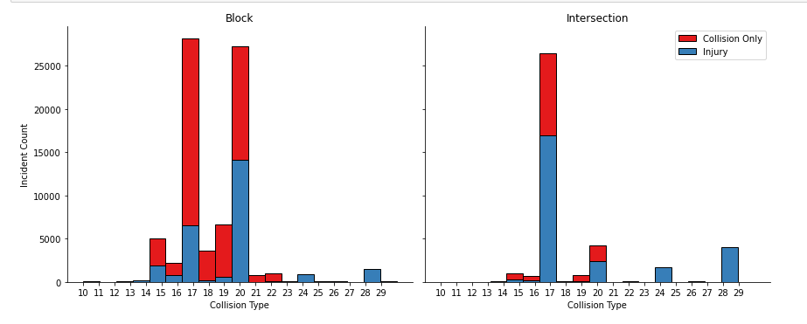
EXPLORATORY DATA ANALYSIS
The Relationship Between
Collision Type, Location and Severity
Man vs. Machine
Basic Physics = Injury
Not many incidents though
Machine vs Machine On the Block (i.e., between intersections)
~2/3s of incidents
High likelihood of injury from “Rear-end”
Machine vs Machine In Intersection
~1/3 of incidents
High likelihood of injury from “Head-On” collision
Note historical focus on intersections and controls therein…
“Head-On”
“Rear-End”

Slide 5
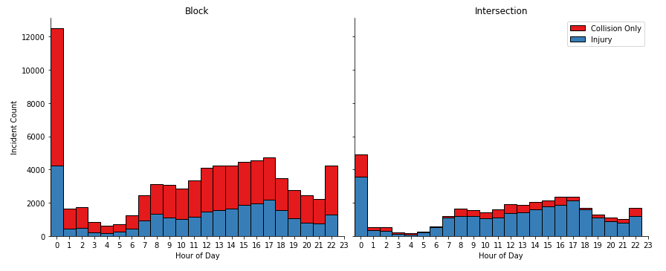
EXPLORATORY DATA ANALYSIS
The Relationship Between
Time of Day, Location and Severity
Ratios of Collision vs Injury Fairly Consistent
Counts Increase During “Workday”
Why Not More in the Morning?
Or During the Lunch Hour?
“Bad Data”

Slide 6
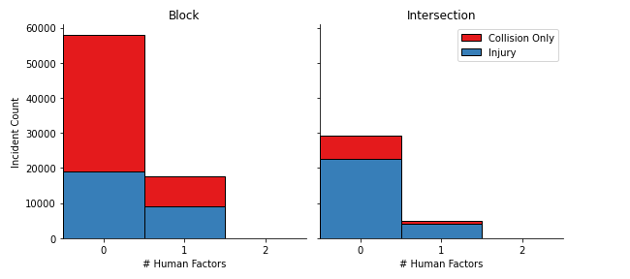
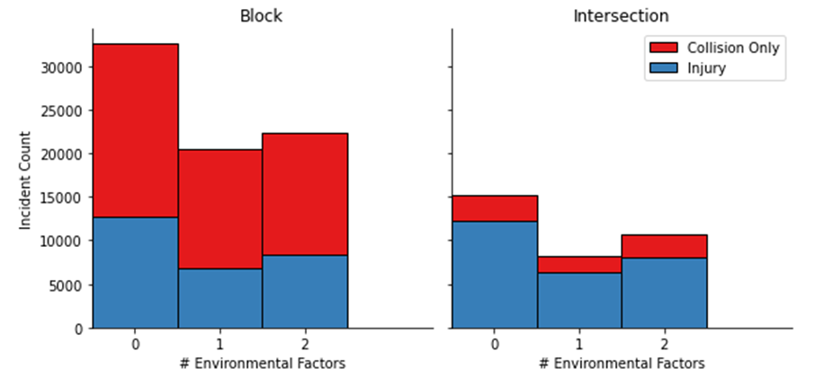
EXPLORATORY DATA ANALYSIS
The Relationship Between
Human & Environment Factors, Location and Severity
Human Factors: Speeding and Driver Inattention (known) Seem to Play a Minor Factor
Environmental Factors: Weather, Lighting and Road Conditions Appear to Play a Major Factor
Note: Numbers are Counts of Factors

Slide 7
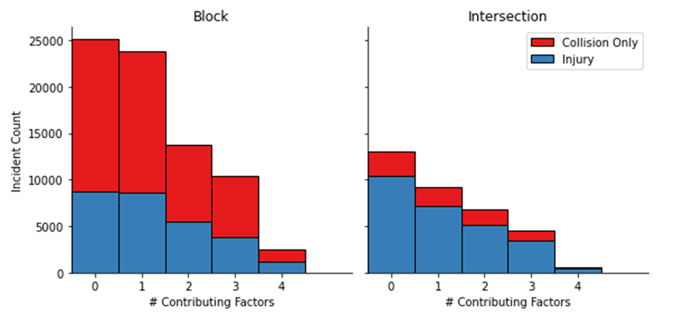
EXPLORATORY DATA ANALYSIS
The Relationship Between
Contributing, Location and Severity
Total Counts of Some Contributing Factor (i.e., Human or Environmental) are Present in 65% of ALL Incidents

Slide 8
Interim SUMMARY DATA ANALYSIS
The Relationship Between
Contributing, Location and Severity
Intersection incidents tend to be 'head-on' and Block incidents tend to be 'rear-end.'
Intersections: ~1/3 of total incidents occur in intersections with ~66% of these 'head-on' incidents resulting in injury
Human factors (i.e., SPEEDING and INATTENTIVENESS) seem to be a minor factor.
Environmental factors (i.e., LIGHTING, WEATHER, etc.) appear to contribute significantly
Block: ~2/3s of total incidents are within the block infrastructure:
~50% of these are 'rear-end' events with an ~50% injury rate
~50% of these are 'head-on' events with ~25% injury rate
Human factors (i.e., SPEEDING and INATTENTIVENESS) seem to be a minor factor.
Environmental factors (e.g., reduced visibility) seem to contribute in a major way
Regardless of location, when motor vehicles impact pedacyclists or pedestrians, the result is almost always injury.
Some Contributing Factor (e.g., Human or Environmental) is present in ~2/3s of all incidents.
The severity code ratios appear to hold across time of the day. Though there does appear to be more incidents as the day goes on until 1700.
The Number of Incidents Between Intersections Was a Surprise
Intersection Injuries: “Head-On”
~ 1/3 of Total Incidents
Block Injuries: “Rear-End”
~1/3 of Total Incidents
Some Contributing Factor in 2/3s of Incidents

Slide 9
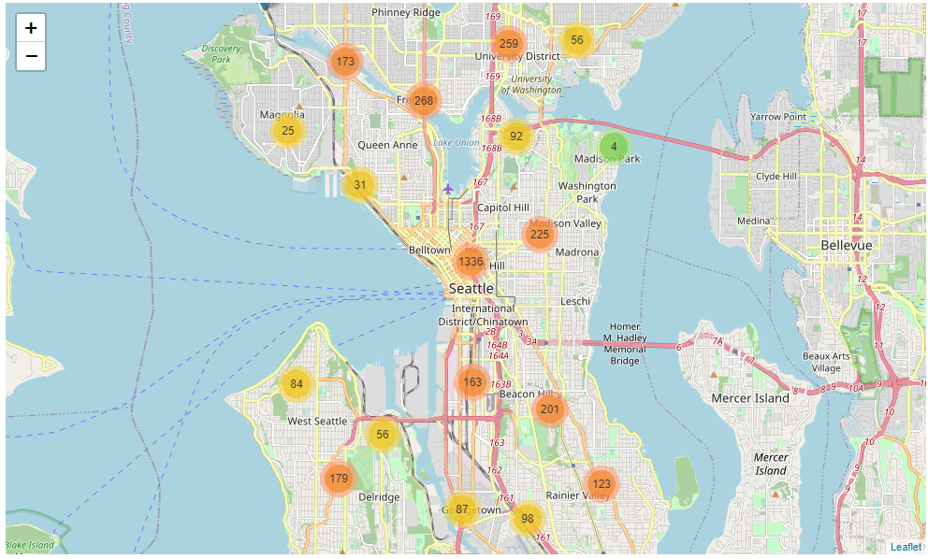
Interim Map Based ANALYSIS
The Relationship Between
Location and Severity
Most Incidents are Clustered Downtown in High Traffic Density
Also Along Major Travel Routes

Slide 10
Choosing a prediction model
Applying Predictive Analytics
In this Analysis, Logistic Regression is the Better Model
Based on Available Data, ~70% of Injury Outcomes can be Predicted Accurately
Algorithm | Jaccard | F1_Score | LogLoss
KNN | 0.688673 | 0.686588 | NA
Decision Tree | 0.703648 | 0.664863 | NA
SVM | 0.705951 | 0.655852 | NA
Logistic Regression | 0.700761 | 0.779769 | 0.575659

Slide 11
REsults
Future Directions
For City Planners: Some means of educating the public on the dangers posed by 'rear-end' incidents while 'on the Block.' Control methods may need researched and explored regarding the findings above to reduce risks.
For Transportation Manufacturers: Exploration of sensors to aid in assisted braking, lane control, attention monitoring, etc. may reduce risks.
For Innovators: Pursuit of developmental technologies to support City Planners, Transportation Manufacturers and Vehicle Operators in risk reduction.
For Insurers: Incentivizing City Planners, Transportation Manufacturers and vehicles operators to purchase supporting technologies and promoting driver education programs.
For Government Entities at all levels: Research investment into methods, technologies, training or other means to mitigate the risk findings is needed. It would be useful to determine if these finds hold true across many cities.
Intersection Incidents: ~1/3 of All
~66% are ‘Head-On’
Result: Injury
Block Incidents: ~ 2/3s of All
This May Surprise Some People
~50% are “Head-On” w/ 25% Injury
~50% are “Rear-End” w/ 50% Injury
~65% had Contributing Factor (s)
Human Factors: Minor Contributor
Environmental Factors: Major Contributor
Majority are Downtown

